Slide 1
7
SERIES OF FUNCTIONS
Copyright © Cengage Learning. All rights reserved.

Slide 2
7.1
Power Series
Copyright © Cengage Learning. All rights reserved.

Slide 3


Power Series
A power series is a series of the form
where x is a variable and the c_{n}’s are constants called the coefficients of the series.
For each fixed x, the series is a series of constants that we can test for convergence or divergence.
A power series may converge for some values of x and diverge for other values of x.

Slide 4

Power Series
The sum of the series is a function
whose domain is the set of all x for which the series converges.
Notice that f resembles a polynomial. The only difference is that f has infinitely many terms.

Slide 5
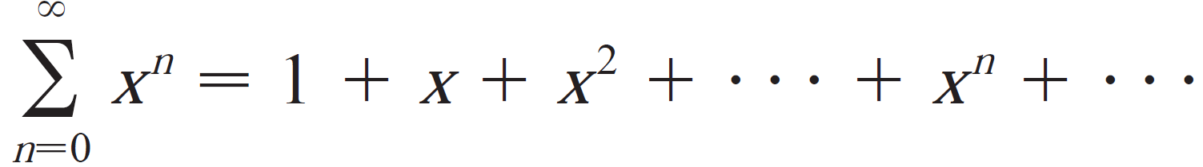
Power Series
For instance, if we take c_{n} =1 for all n, the power series becomes the geometric series
which converges when -1< x <1 and diverges when |x| >= 1.

Slide 6


Power Series
More generally, a series of the form
is called a power series in (x – a) or a power series centered at a or a power series about a.
Notice that in writing out the term corresponding to n = 0 in Equations 1 and 2 we have adopted the convention that
(x – a)⁰ = 1 even when x = a.
Notice also that when x = a all of the terms are 0 for n ≥ 1 and so the power series always converges when x = a.

Slide 7
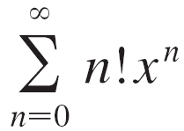


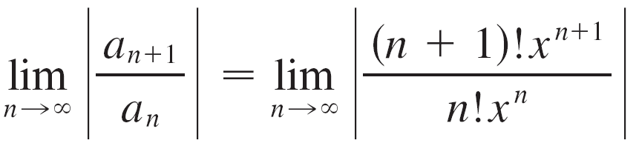
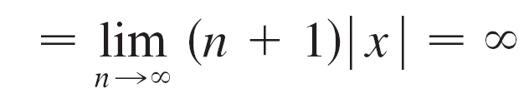
Example 1
For what values of x is the series converge?
Solution:
We use the Ratio Test. If we let a_{n}, as usual, denote the nth term of the series, then
If we have
By the Ratio Test, the series diverges when .
Thus the given series converges only x = 0.

Slide 8

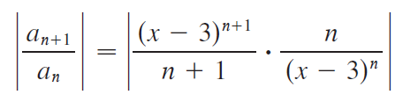
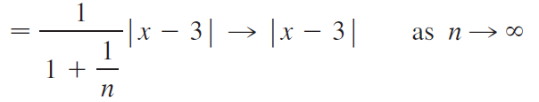
Example 2
For what values of x does the series converge?
Solution:
Let a_{n} = (x – 3)^{n}/n. Then

Slide 9


Example 2 – Solution
cont’d
By the Ratio Test, the given series is absolutely convergent, and therefore convergent, when and divergent when
Now
so the series converges when 2 < x < 4 and diverges when
x < 2 or x > 4.

Slide 10

Example 2 – Solution
cont’d
The Ratio Test gives no information when so we must consider x = 2 and x = 4 separately.
If we put x = 4 in the series, it becomes Σ 1/n, the harmonic series, which is divergent.
If x = 2, the series is Σ (–1)^{n}/n, which converges by the Alternating Series Test.
Thus the given power series converges for 2 ≤ x < 4.

Slide 11
Power Series
We will see that the main use of a power series is that it provides a way to represent some of the most important functions that arise in mathematics, physics, and chemistry. In particular, the sum of the power series in the next example is called a Bessel function.

Slide 12


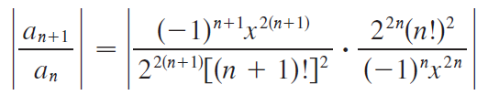
Example 3
Find the domain of the Bessel function of order 0 defined by
Solution:
Let
Then

Slide 13



Example 3 – Solution
cont’d
Thus by the Ratio Test the given series converges for all values of x.
In other words, the domain of the Bessel function J₀ is

Slide 14
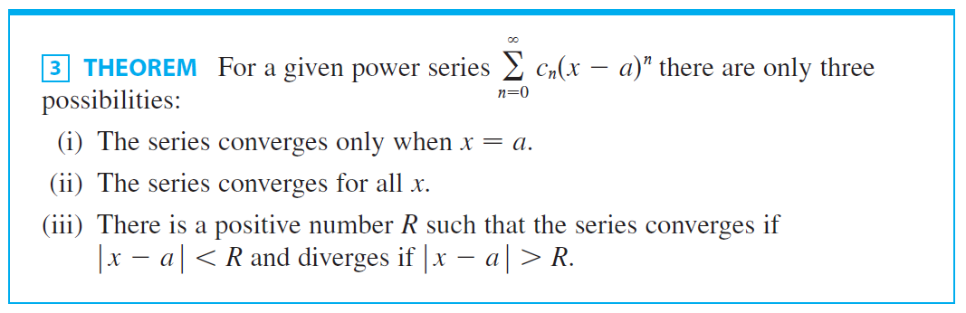

Power Series
The number R in case (iii) is called the radius of convergence of the power series. By convention, the radius of convergence is R = 0 in case (i) and R = in case (ii).

Slide 15

Power Series
The interval of convergence of a power series is the interval that consists of all values of x for which the series converges.
In case (i) the interval consists of just a single point a. In case (ii) the interval is (– , ). In case (iii) note that the inequality can be rewritten as a – R < x < a + R.
When x is an endpoint of the interval, that is, x = a ± R, anything can happen—the series might converge at one or both endpoints or it might diverge at both endpoints.

Slide 16
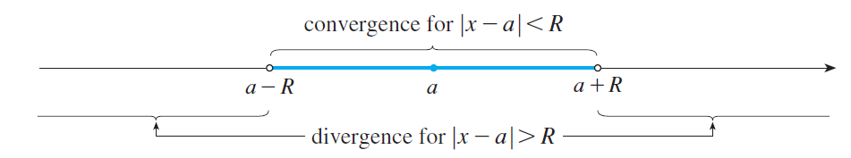
Power Series
Thus in case (iii) there are four possibilities for the interval of convergence:
The situation is illustrated in Figure 3.
Figure 3

Slide 17
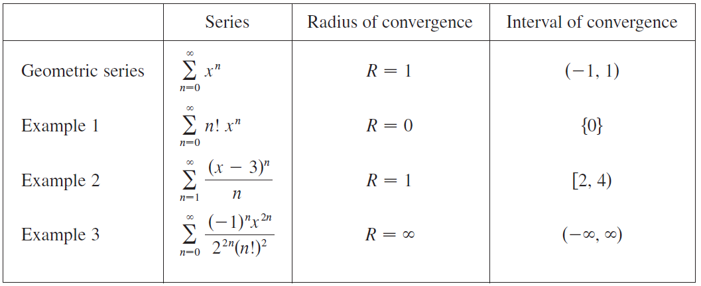
Power Series
We summarize here the radius and interval of convergence for each of the examples already considered in this section.

Slide 18


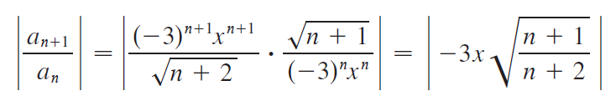
Example 4
Find the radius of convergence and interval of convergence of the series
Solution:
Let
Then

Slide 19
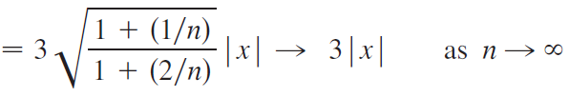






Example 4 – Solution
cont’d
By the Ratio Test, the given series converges if and diverges if
Thus it converges if and diverges if This means that the radius of convergence is
We know the series converges in the interval but we must now test for convergence at the endpoints of this interval.

Slide 20

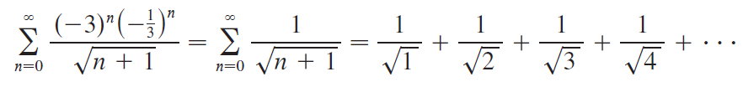


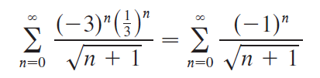
Example 4 – Solution
cont’d
If the series becomes
which diverges. (Use the Integral Test or simply observe that it is a p-series with )
If the series is
which converges by the Alternating Series Test.

Slide 21


Example 4 – Solution
cont’d
Therefore the given power series converges when so the interval of convergence is

